Slide 1
Remote Sensing
Instructor: Professor Yuji Murayama
Teaching Assistant: Niloofar Haji Mirza Aghasi

Slide 2
What is remote sensing used for?
Remote sensing is a method for getting information about of different objects on the planet, without any physical contacts with it.
Image Source: cimss.ssec.wisc.edu

Slide 3
What is remote sensing?
Remote sensing is a technology foe sampling electromagnetic radiation to acquire and read non-immediate geospatial data from which to pull info more or less features and objects on his Earths land surface, seas, and air.
- Dr. Nicholas Short

Slide 4
Advantages of Remote Sensing
Provides a view for the large region
Offers Geo-referenced information and digital information
Most of the remote sensors operate in every season, every day, every time and even in real tough weather

Slide 5
Elements of Remote Sensing
Source:staff.aub.edu.lb

Slide 6
Remotely Sensed Data
Landsat/Ikonos/Quickbard/Aster

Slide 7
Satellite pictures
Satellite imagery consists of photographs from which collected by satellites.
Japan Satellite View
Image Source: www.wonderwhizkids.com
Image Source: www.loneotaku.net

Slide 8
Satellites offer a Global View
What does satellite imagery give you?
-Information on land cover, land use, habitats, landscape and infrastructure
-multiple engagements by time series
-Mapping and monitoring changes and predict future

Slide 9
Application of Remote Sensing
Urbanization & Transportation
Urban planning
Roads network and transportation planning
City expansion
City boundaries by time
Wetland delineation
Image source: www.ldeo.columbia.edu
Image source: www.geospectra.net

Slide 10
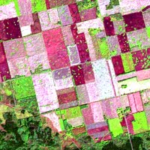
Application of Remote Sensing
Agriculture
The application of remote sensing in agriculture include:
- Soil sensing - Farm classification - Farm condition assessment - Agriculture estimation - Mapping of farm and agricultural land characteristics - Mapping of land management practices - Compliance monitoring
© Wageningen UR 2002

Slide 11
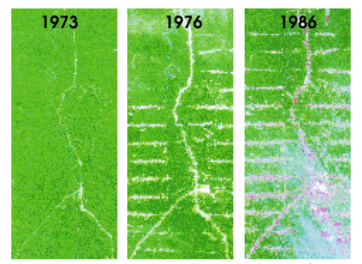
Application of Remote Sensing
Natural resource Management
Forestry: biodiversity, forest, deforestation
Water source management
Habitat analysis
Environmental assessment
Pest/disease outbreaks
Impervious surface mapping
Hydrology
Mineral province
Geomorphology
Md. Bodruddoza Mia

Slide 12
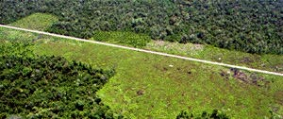
Satellite image of deforestation
Comparison of an aerial photograph (bottom) with a radar image (top) of deforestation along a road
© Wageningen UR 2002

Slide 13
Application of Remote Sensing
Land Use
Land cover means any surface cover on the ground which can include vegetation, urban infrastructure, water, lake, mountain, transportation networks, buildings or any other. The attributes measured by remote sensing techniques relate to land cover, from which land use can be inferred, particularly with ancillary data or a priori cognition.

Slide 14
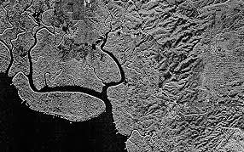
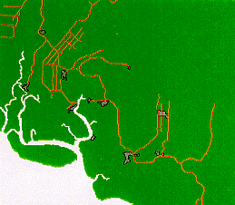
Mapping
Generating different maps from remotely sensed data can be so effective ad valuable. A classification of sensing elements and methodologies to generate theses remotely sensed models are essential for mapping. Two primary methods of generating elevation data are:
1. Stereogrammetry techniques by air photos 2. Radar interferometry
Radar image of a continuously clouded area
Map with the road network
© Wageningen UR 2002

Slide 15
Types of Satellites
Geostationary Satellites
A geostationary satellite is one of the satellites which is getting remote sense data and located satellite at an altitude of approximately 36000 kilometres and directly over the equator.
Image Source: cimss.ssec.wisc.edu

Slide 16
Types of Satellites
Polar-Orbiting Satellites
A polar orbit is a satellite which is located near to above of poles. This satellite mostly uses for earth observation by time.
Image Source: globalmicrowave.org

Slide 17
Some Image Processing Software
ERDAS Imagine
ENVI
ILWIS
ArcGIS

Slide 18
Reference
Jan Clevers, EXAMPLES OF APPLICATIONS WITH REMOTE SENSING IMAGES, Centre for Geo-Information,Dept. Environmental Sciences,Wageningen UR.
Md. Bodruddoza Mia, Remote Sensing, GIS and Its application, Earth Resources Engineering, Kyushu University, Japan.
Olga Wilhelmi, GIS in Weather and Society, Institute for the Study of Society and Environment
National Center for Atmospheric Research
Somchai Baimoung, Meteorological Early Warning Systems for Prevention and Mitigation of Natural Disasters:Case of Maa Wang River Basin, Weather Forecast Bureau,Thai Meteorological Department.

